Slide 1
Entity Framework
Akash Bhosale
CSE686- Internet Programming
Spring 2019

Slide 2
What is Entity Framework?
Entity Framework is an open source ORM framework for .NET applications.
An ORM manages details between set of objects and the underlying relational database.
Alternatively traditional ADO.NET classes can be used:
SqlConnection
SqlCommand
SqlDataReader
SqlDataAdapter
However, Entity Framework can handle all data related interactions between the application and the database.
Advantages: Auto generated code, faster development time, auto migrations
User Interface
Business Layer
Persistence Framework
(Entity Framework)
Database
Entity Framework in an application

Slide 3
Workflows
Database First
Code First
Model First
Allows reverse engineering a model from existing database
EF generates domain classes.
Allows creating and updating of database tables based on domain classes.
EF generates database tables.
Create an UML diagram using a Visual Designer and then let the workflow generate the database.

Slide 4
Entity Framework Architecture
EDM (Entity Data Model) :
Storage Model : Includes tables, views, stored procedures, relationships and keys.
Conceptual Model : Contains model classes and their representation.
Mapping Model: Information about how conceptual model is mapped to the storage model.
LINQ to Entities: Used to write queries against the object model. Returns entities defined in the conceptual model.
Entity SQL: It is a storage independent query language.
Object Services: Main entry point for accessing data from the database and returning it back.
Entity Client Data Provider:
Communicates with the ADO.NET data provider.
Converts LINQ-to-Entities or Entity SQL to SQL query.
ADO.NET Data Provider: Communicates with the database using ADO.NET.
LINQ to Entities
Entity SQL
EDM
Conceptual Model
Object Services
Mapping
Entity Client Data Provider
Storage Model
ADO.NET Data Provider
Database
Entity Framework Architecture
Source: http://www.entityframeworktutorial.net/EntityFramework-Architecture.aspx

Slide 5
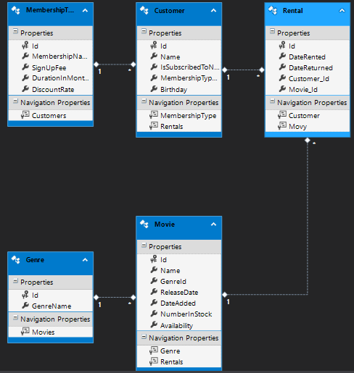
Database First
Database
Entity Framework
Context and Entity classes
Database-First Approach
Generate Domain Classes based on the database
Edmx Designer Representation

Slide 6
Dealing with Database Changes
Adding a new table
Adding a new column
Modifying a table column
Modify column type
Importing stored procedures

Slide 7
Code First
Domain Classes
Entity Framework
Database
Code-First Approach

Slide 8
Migrations
Adding a new tables
Seeding the database with SQL queries
Modifying existing classes
Adding new property
Modifying existing property
Overriding conventions using Data Annotations

Slide 9
LINQ
Language Integrated Query
Example :
movieQuery = movieQuery. Where(m => (m.Name.Contains(query) && m.Availability > 0))
Query Data using LINQ and Extension Methods.
Deferred Execution

